Slide 1
Lecture 7: Model Selection & Assessment

Slide 2
New terminology
“Validation set” – a data set, like the training and test sets, but that’s used to evaluate the model/algorithm used
  Can be a subset of the training set (as we saw last time)
  Could also be a former test set:
    You make a self-driving car using a bunch of training data
    You set the car up on a course, and how it behaves on this course is the test data
    Now, take that test data to evaluate your car, it’s the validation set
    If it passes validation, toss the validation set and put it on the road with the user experience being the new test sets

Slide 3
Cross validation
As we talked about last time, cross validation (or cross-validation) is a way to get example test data by using a fraction of training data as test data (while removing that fraction from your training data)
It works by separating the data into “groups” and evaluating by training on all groups except one and then testing on that one. You would then switch the “one” that is being used as the test until all groups have been test groups

Slide 4
How many groups should you have? Or, put another way, how many “pieces” of data should be in each group?

Slide 5
Well, let’s take the extremes
Have the training set be a single piece of data, validation set will be all the other pieces. Then, repeat by switching what the one piece is and averaging.
  Is this good? Why or why not?
Have the training set by all data except a single piece, validation set will be a single piece of data. Then, repeat by switching what the one piece is and averaging.
  Is this good? Why or why not?

Slide 6
Leave-one-out (LOO) cross validation
Consider a validation set with 1 example:
  D – training data
  D_{j} – training data with the jth data point (x_{j}, y_{j}) moved to the validation set
Learn classifier f_{Dj} with D_{j} dataset
Estimate the error based on predicting y_{j}
  This is an unbiased estimate of the true error of f_{Dj}, which should be ~f_{D}

Slide 7
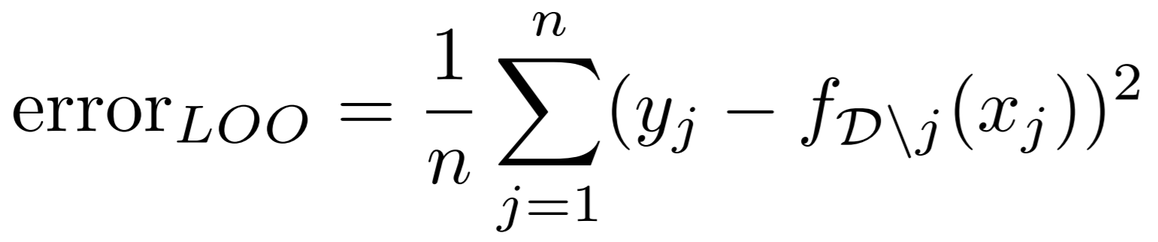
Leave-one-out (LOO) cross validation
Okay, I’ve got an estimate based on a nearly complete training dataset, but the estimate is based on a validation set of size 1, soo…
LOO cross validation – average over all possible data points, j:
  For each j left out, build a new classifier/algorithm f_{Dj}
  Estimate the error as:
  Or, the average squared difference between the measurement and the prediction

Slide 8
Leave-one-out (LOO) cross validation
LOO cross validation (LOOCV) is an almost unbiased estimate of the true error (very, very close in most cases)
  You are measuring your error in an unbiased way for f_{Dj}, but it isn’t exactly equal to your error for f_{D}
  So, it isn’t an estimate of the true error if you had all N data points (but if N is large, it is very, very close)
LOO is an extremely powerful, virtually unbiased method for model selection. Feel free to use it for almost any application!

Slide 9
Too good to be true…
What’s the computational cost of LOO/LOOCV?
Suppose you:
  Have 100,000 data points
  Have an efficient machine learning algorithm that only takes 1 second
  How long would the validation take?

Slide 10
LOOCV
A lot of this class will be:
  “Wow, this is great!”
  “Well, it doesn’t actually work that well with real data, is slow, etc.”
  Cross validation is powerful but slow, and as such has many, many potential applications, particularly:
    Not that much data
    You don’t care about the time to test your algorithm (say, you want to publish your algorithm)

Slide 11
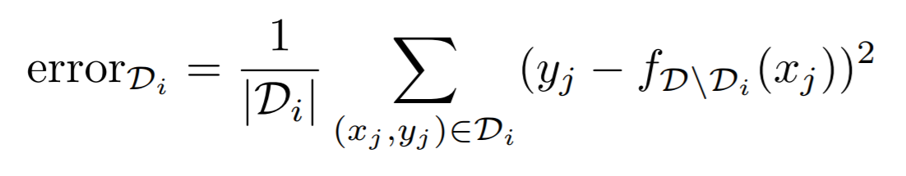
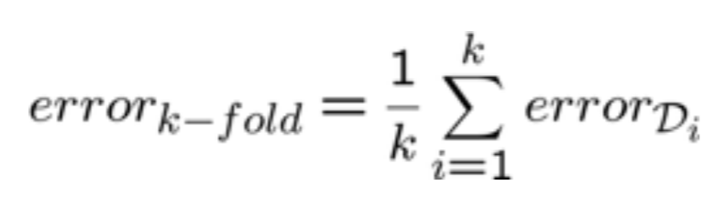
k-fold Cross Validation
Randomly divide data into k equal parts
  D₁, D₂, …, D_{k}
For each i from 1 to k:
  Learn classifier f_{D\Di} using all data except data in D_{i}
  Estimate error of f_{D\Di} on the validation set, D_{i}:

Slide 12
k-fold Cross Validation
k-fold cross validation is:
  Much faster to compute than LOO
  More biased (uses much less data)
  Depends on user to select k (10 is pretty standard but can vary quite a bit)

Slide 13
Limitations of cross validation
You have relatively little data, say 20 examples
  k-fold cross validation is a bad choice since there won’t be much validation data in any one error test
  LOO would work, but what if you want to know the error for a particular example x instead of the whole data?

Slide 14
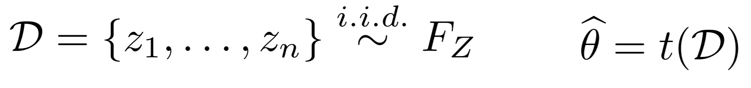
Bootstrapping
Given a set of data that are independent and identically distributed (i.i.d.) samples, D = {Z₁, Z₂,…Z_{n}}, we want to compute θ
For b=1, 2,…B, we define the bth bootstrapped dataset as drawing n samples with replacement from D

Slide 15
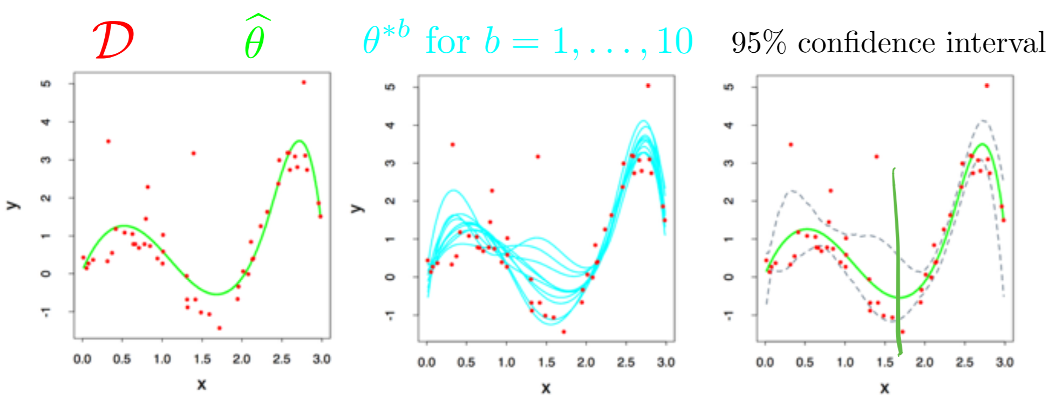
Bootstrap applications
Common applications of the bootstrap:
  Estimate parameters that escape simple analysis like the variance or median of an estimate
  Confidence intervals
  Estimates of error for a particular example:

Slide 16
Bootstrap takeaways
Advantages:
  Bootstrap is very generally applicable. Build a confidence interval around anything
  Very simple to use
  Appears to give meaningful results even when the amount of data is very small
  Very strong asymptotic theory (as num. examples goes to infinity)

Slide 17
Bootstrap takeaways
Disadvantages:
  Very few meaningful finite-sample guarantees
  Potentially computationally intensive
  Reliability relies on test statistic and rate of convergence of empirical CDF to true CDF, which is unknown
  Poor performance on “extreme statistics” (e.g., the max)

